Slide 1
Hello!
Group 5:
Christian Frans Mukuan
Deyaninta Ekabriela Permata
Mufadhal Faraz Addhifa
Notes:
> Fadhal

Slide 2
The Topic We Talk About
Virtual Memory in Windows 10
Notes:
> Fadhal

Slide 3
Agenda
Describes definition of Operating System
Describes definition of Windows 10
Describes definition of Memory
Describes definition of Virtual Memory
Describes steps to manually set page file in Windows 10
Describe steps to change the location a page file in Windows 10
Conclusion and Suggestion
Notes:
Christ
So, here are our Agenda for Today’s ISAS.
For the first segment, we will tell you what is Operating System
The second, it is all about Windows 10
Third, about Memory
Fourth, about our Main Research, Virtual Memory
Fifth, We will tell you how to manually set the page file in Windows 10
Sixth, it’s actually the same with fifth but with different subject, to Change the location of a page file in Windows 10
Seventh, is for our Conclusion and Suggestion of what we have tell to y’all

Slide 4
What is
Operating System
Notes:
> Fadhal

Slide 5
What is
Windows 10
Notes:
> Fadhal

Slide 6
What is
Memory ?
Notes:
> Deya

Slide 7
What is Virtual Memory?
Notes:
Chris
So, Virtual Memory is a system that used by the operating system to use a portion of the Secondary Memory, the Harddisk using it as internal / main memory (RAM) that physically installed in a computer system. This system operates by transferring some unneeded code to a file on the hard drive called the page file.
On the next segment, We will tell you how to manually set the page file in Windows 10

Slide 8
Steps to Manually Set Page File In Windows 10
Notes:
> Fadhal

Slide 9
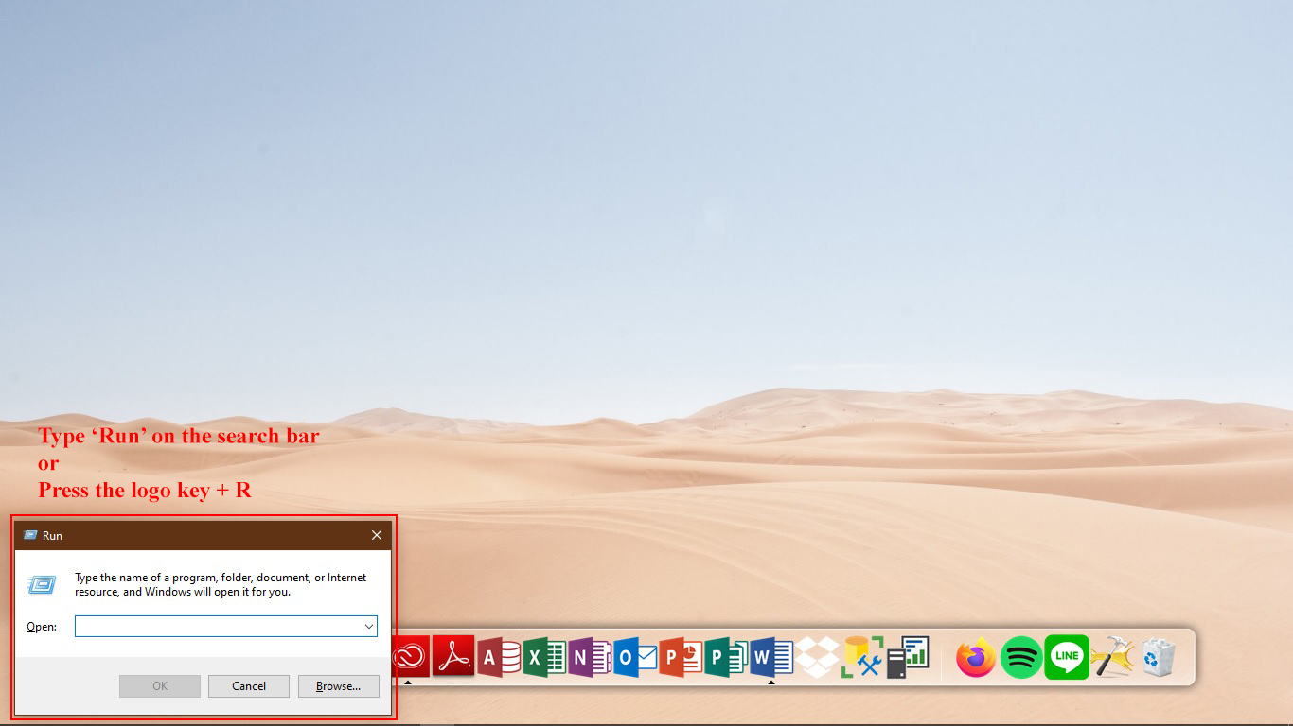
1
Notes:
> Fadhal

Slide 10

2
Notes:
> Fadhal

Slide 11
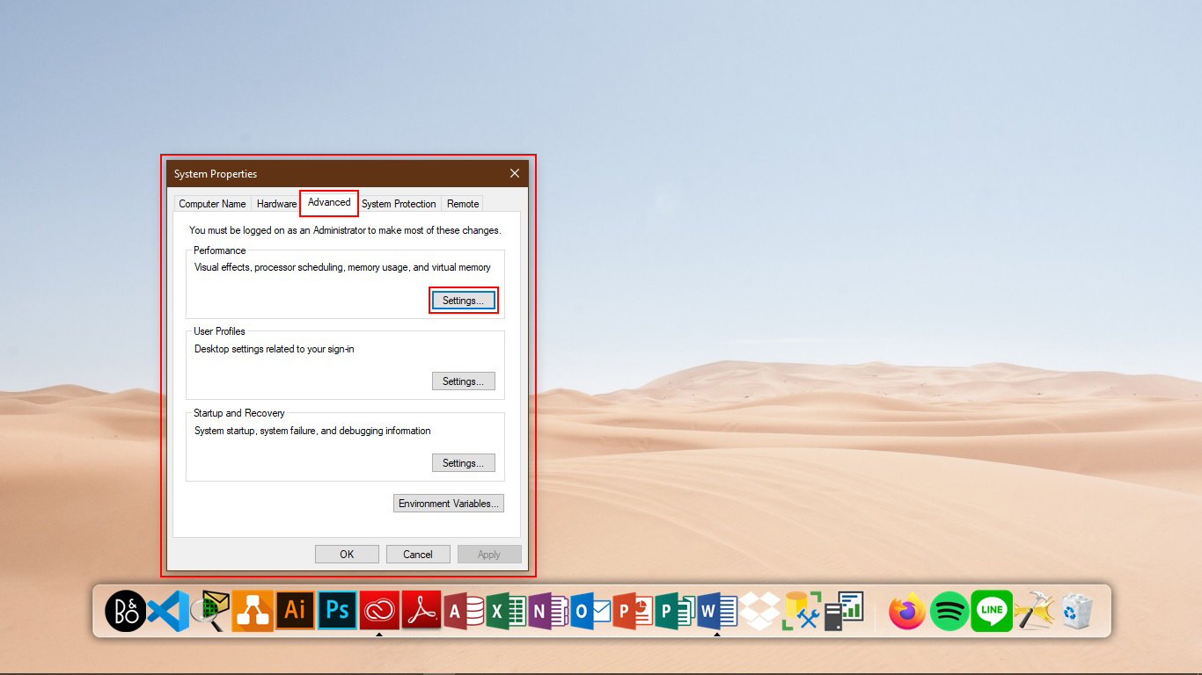
3
Notes:
> Fadhal

Slide 12
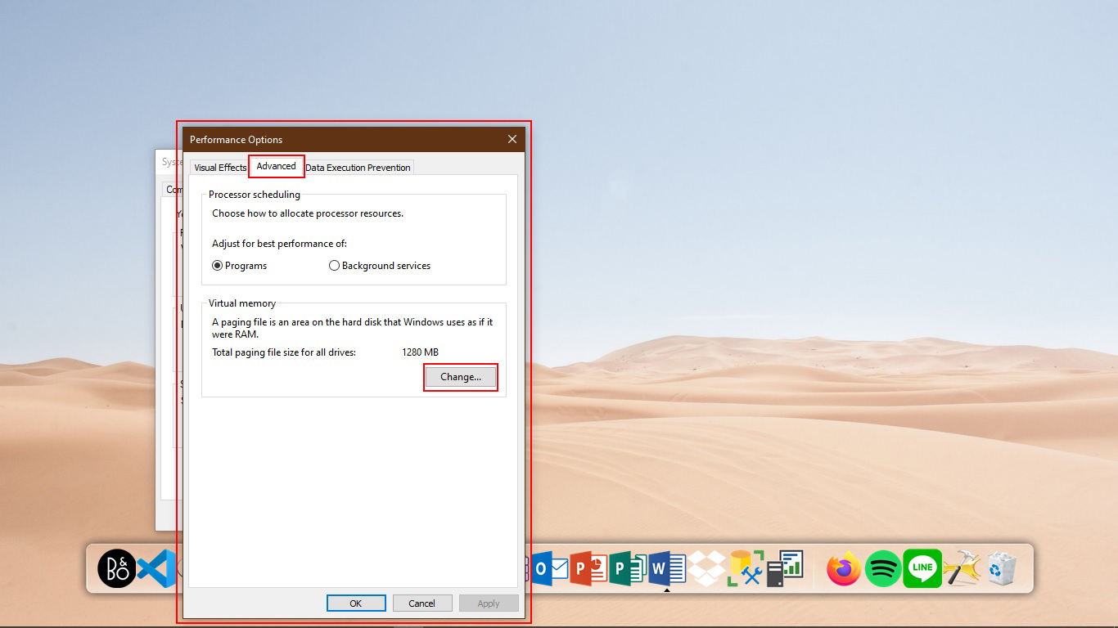
4
Notes:
> Fadhal

Slide 13
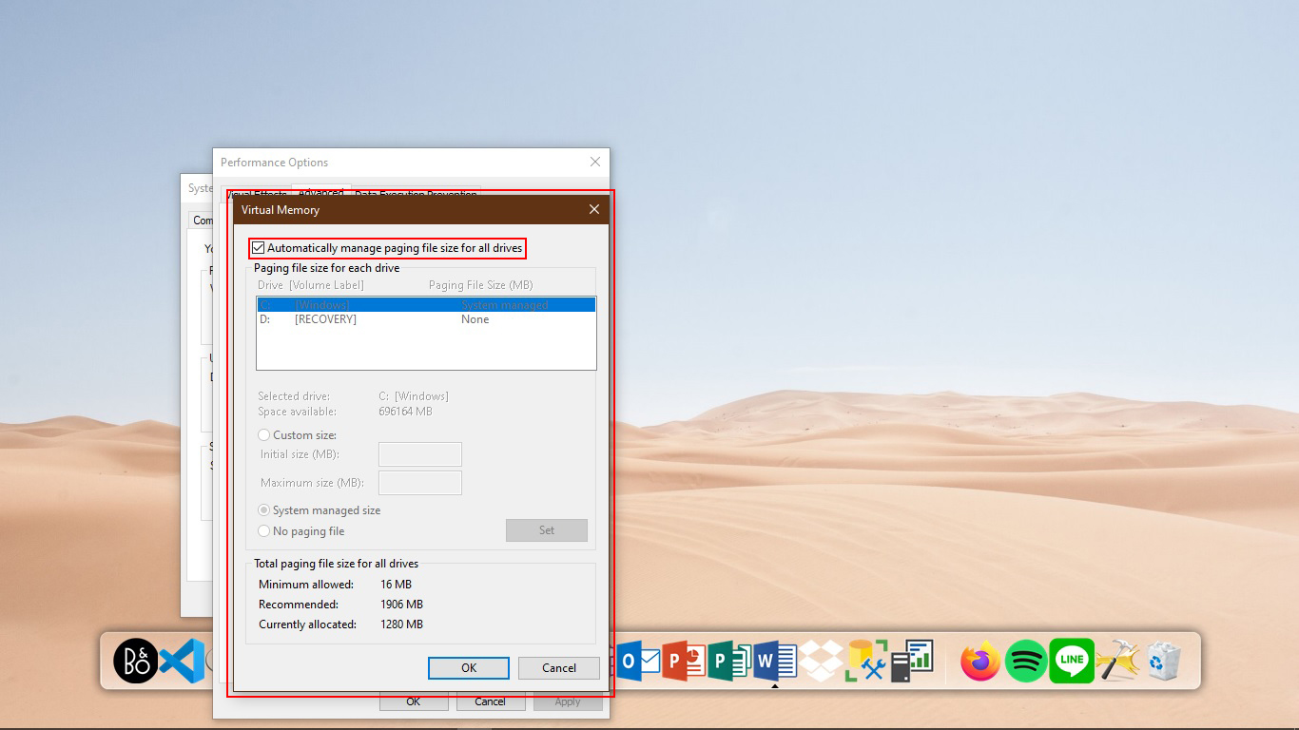
5
Notes:
> Fadhal

Slide 14
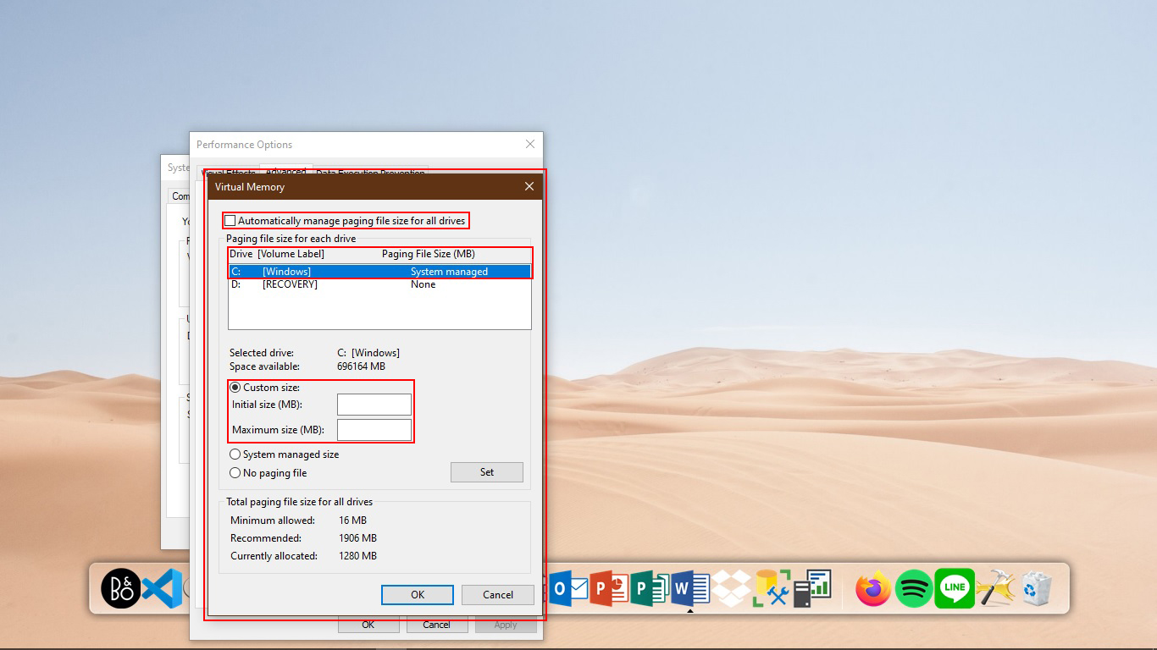
5.1
Notes:
> Fadhal

Slide 15
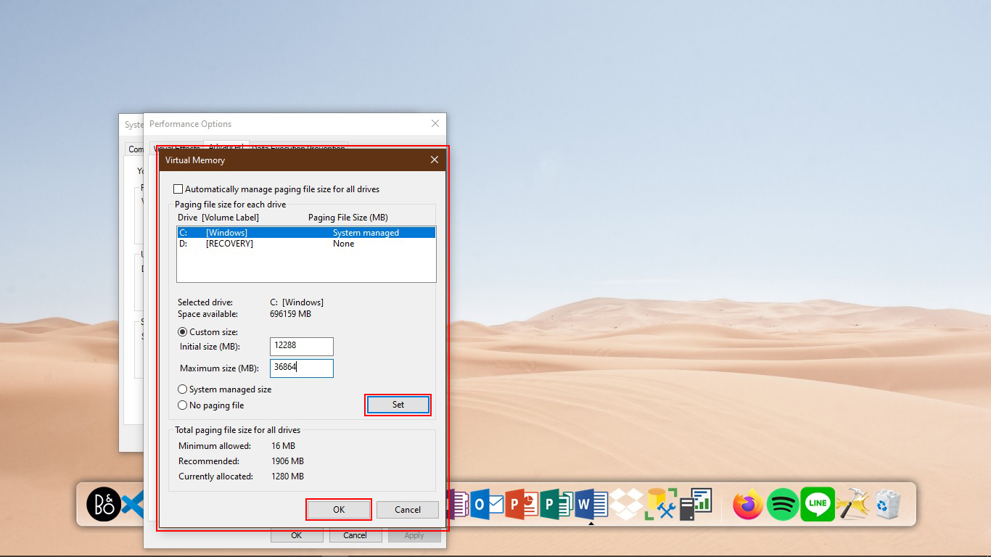
6
Notes:
> Fadhal

Slide 16
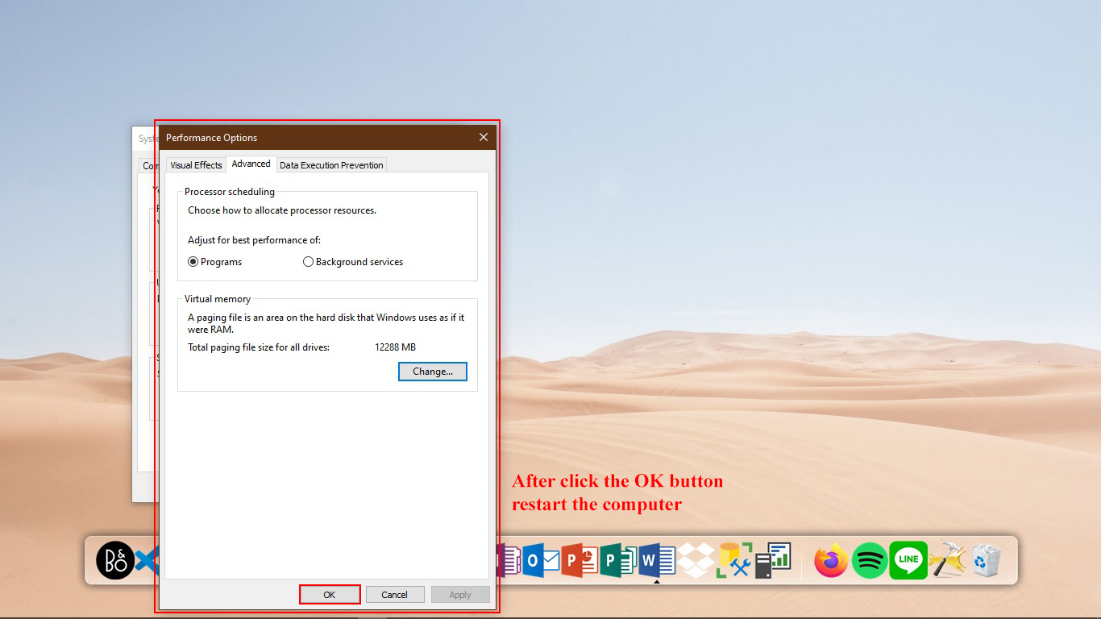
7
Notes:
> Fadhal

Slide 17
Steps to Change the Location of page file
Notes:
> Deya

Slide 18
1
Notes:
> Deya

Slide 19
2
Notes:
> Deya

Slide 20
3
Notes:
> Deya

Slide 21
4
Notes:
> Deya

Slide 22
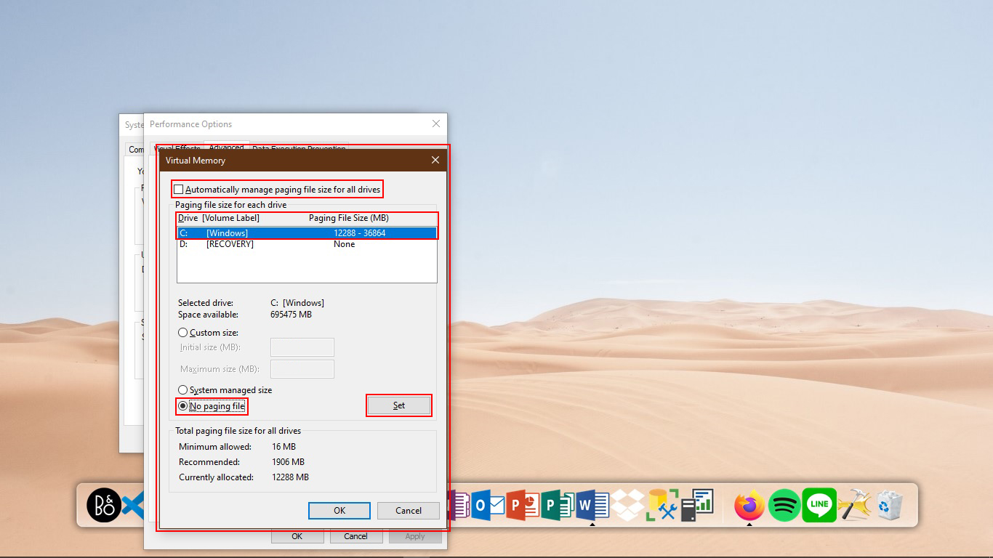
5
Notes:
> Deya

Slide 23
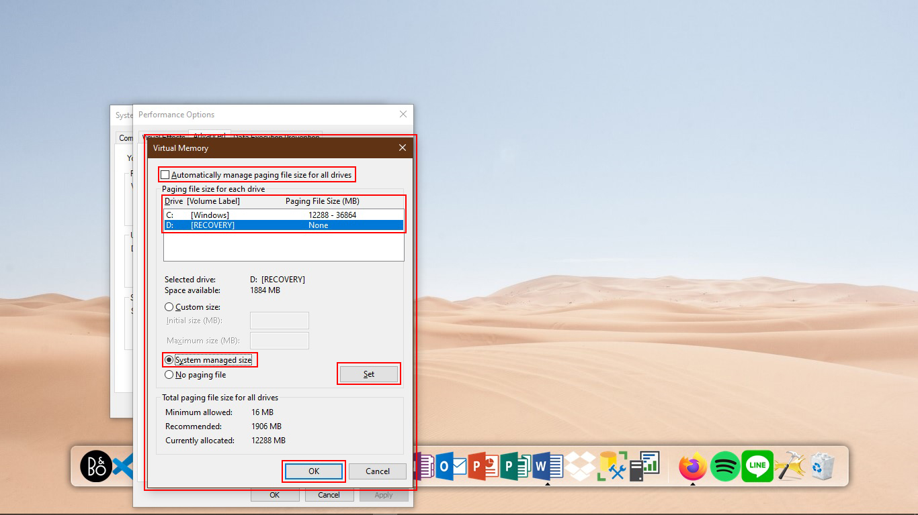
6
Notes:
> Deya

Slide 24
The Function Of
Virtual Memory
Notes:
> Fadhal

Slide 25
Handle the excess load of RAM
Becomes a backup RAM, but does not replace the RAM function.
Saves data from RAM, but not transferred to the processor
Data that stored in virtual memory (paging file) is temporary
Notes:
1 Fadhal
2 Deya
3 Christ
4 Christ
Virtual memory serves as a backup memory which only helps to overcome the lack of memory capacity. Unlike RAM, virtual memory does not forward data stored for processing by the processor.
Just like RAM, Virtual memory will be empty after the computer turned off. The paging file or data contained in the SWAP partition will also be deleted after the computer turned off

Slide 26
Conclusion
From this ISAS, we can conclude that virtual memory still become one of the most important in computer system, although many user do not want to know or understand more about virtual memory.
Notes:
>

Slide 27
Suggestion
From this ISAS, we can suggest anyone who uses computer to know more and try to start thinking that virtual memory is one from many important things or part that need to exist in our computer system.
Notes:
>

Slide 28
THANK
YOU
THANK
YOU

Slide 29
SlidesCarnival icons are editable shapes.
This means that you can:
Resize them without losing quality.
Change fill color and opacity.
Isn’t that nice? :)

Slide 30
😉
Now you can use any emoji as an icon!
And of course it resizes without losing quality and you can change the color.
How? Follow Google instructions https://twitter.com/googledocs/status/730087240156643328
✋👆👉👍👤👦👧👨👩👪💃🏃💑❤😂😉😋😒😭👶😸🐟🍒🍔💣📌📖🔨🎃🎈🎨🏈🏰🌏🔌🔑 and many more...

